Slide 1
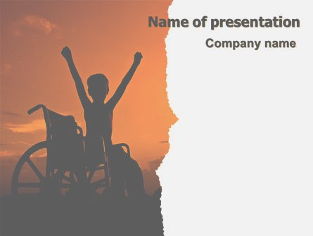
SAKSHAM AN ANDROID APPLICATION
by
Ankita Bajantri
Durgesh Nandan
Nikita Bhavi
Prachi Khandke

Slide 2
The worst thing about a disability is that people see it before they see you
by Easter Seals

Slide 3
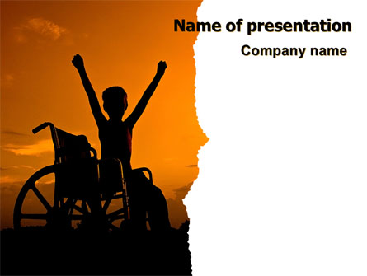
INDEX
PROBLEM UNDERSTANDING
INTRODUCTION
LITERATURE SURVEY
OVERALL DESIGN
ARCHITECTURE
TECHNOLOGY TO BE USED
DEPENDENCIES

Slide 4
STATISTICS
1.37 B
12.6 M
>26%
2.1%
26%
Population of India 2019 est.
People with Disability
Count
Use Smartphones
Our Goal
Data Provided by most recent CENSUS

Slide 5
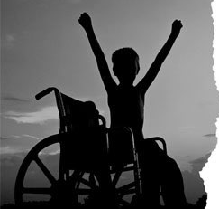
PROBLEM UNDERSTANDING
From time immemorial, man has been struggling against the ravages wrought by disease, accident or feud. The problem of the physically handicapped is, therefore, as old as human life itself. Problems of the physically handicapped vary in time and space. Their problems are multi-dimensional physical, psychological, social, cultural, educational and vocational. Each category of disability poses a different set of problems.
Problem of Physical Mobility
Problem of Reading and Communication
Lack of job-oriented training facilities

Slide 6
Intro duction
A word like handicapped once was used very widely, but now would generally be considered to be not appropriate to use,"
- Dr. Laugesen
People with disabilities are one of the most marginalized and excluded groups in society. Facing daily discrimination in the form of negative attitudes, lack of adequate policies and legislation, they are effectively barred from realizing their rights to healthcare, education, and even survival.
Saksham is an open-source smartphone Android app. It connects the vernacular audience, disabled to be precise with users of the same kind or normal citizens.

Slide 7
Literature Survey
Obstacle detection Based on Monocular Camera and Size Expansion Algorithm and TensorFlow Lite. https://www.ncbi.nlm.nih.gov/pmc/articles/PMC5469666/
Thimbleby, H.: Understanding User Centred Design (UCD) for People with SpecialNeeds, 1611–3349 (2008)26. Henry, S.: Just ask: integrating accessibility throughout design. [United States]:Lulu.com (2007).
https://developer.android.com/docs (Android Documentation)
Object Detection For Mobile and IoT Using TensorFlow Lite(Official) https://www.tensorflow.org/lite/models/object_detection/overview.

Slide 8
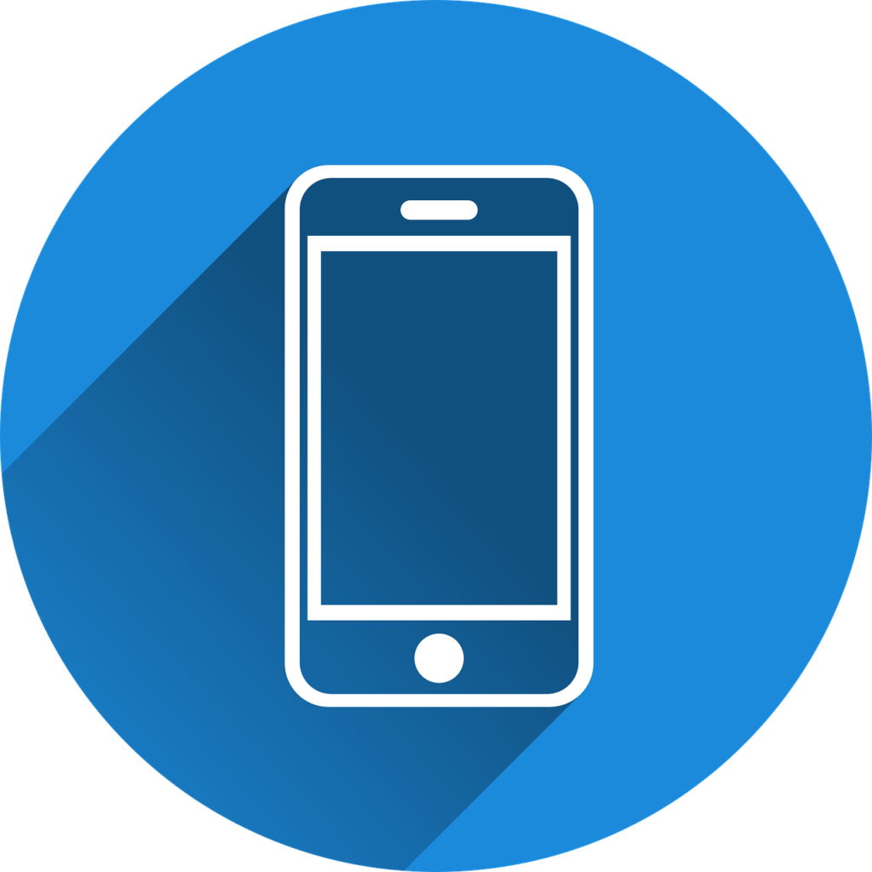





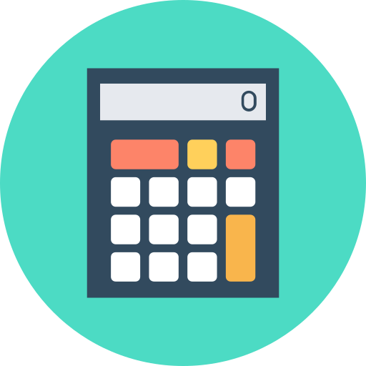
Overall Design
Change the audio profile
AudioBook
(PDF,DOCX)
Object Detection using Monocular Camera
USER
SAKSHAM Application
Locate your Phone
Get Phone Numbers from Passcode

Slide 9
Overall Design
Obstacle Detection using Monocular Camera, Size Expansion Algorithm and TensorFlow Lite.
Get the Phone Numbers from the preset passcode if Phone is left at Home or somewhere else without the use of Internet and only a Simple SMS will do.
Get the location if phone is lost using simple SMS.
Read rich text as audio-book using text-to-speech in regional languages using simple SMS.
Change the audio profile of any phone using simple SMS.

Slide 10
Technology Stack (Architecture)
JAVA
Backend
JSON
NoSQL
on Cloud
Stacking the app into a single package apk
Build
App
DB
Cloud based on NoSQL/JSON/XML
Models for Database
Gradle
XML
Android Build Tool
Frontend

Slide 11
Technology to be used
Android
Android
Full Stack Android Development comprising of Android Studio, Postman, Hibernate, and Service APIs and several SDKs.
Object Detection using TensorFlow Lite
Tensorflow Lite
This app makes use of TensorFlow Lite in Object Detection and felicitate the use of Size Expansion Algorithm and Brute Force Matcher.
Cloud(JSON/NoSQL)
Cloud(JSON/XML/NoSQL)
Cloud is being used as a database in which traditional, structured data is not followed instead it makes use of JSON, NoSQL or XML.
Java/XML
Java/XML
Java is used for back-end and XML is used for front-end.

Slide 12

Dependencies
Internet Connection
Stable Internet connection is required.
Android API level 19
Minimum Version on which App runs: KitKat and later versions.

Slide 13
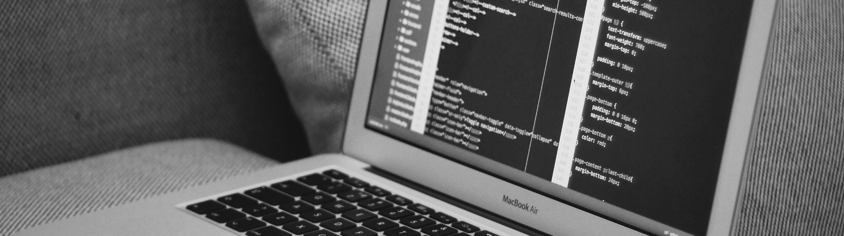
Thank You

